Slide 1




CREDIT SCORE MODEL
Fajar adi prasetio
Fajar Adi Prasetio
FajarAdi25
fajaradiprasetio@gmail.com
Fajaradi25.github.io

Slide 2
Table Of content
Business Understanding
1
Data Preprocessing
2
Exploratory Data Analysis (EDA)
3
Feature Important
4
Modeling & Evaluation
5
Result
6

Slide 3
Business Understanding
Problem
8.93% of creditors have problems paying off credit applications
Goals
The Credit Score Model can help companies ensure that creditors who can make repayments are not rejected and creditors who are unable to make repayments will be rejected when applying for a loan

Slide 4
Business Understanding
Impact
The model can reduce number of defaults by 3.16% and amount of credit by Rp. 899,959,100

Slide 5
Data preprocessing
Dataset Info
Cleaning Data
Missing Value
Replace blank values ​​in categorical data with the most values.
Replace blank values ​​in numeric data with 0
Duplicate Data
There are no duplicate data
Outliers
Using a boxplot to detect outliers
Using interquartile range to determine limit of the data range
33 Columns & 223008 Rows
7 Categorical Data & 25 Numerical Data
Data Transformation
Weight of Evidence (WoE) methodology
Feature Selection
Using Multicollinearity Prevention with Pearson Correlation

Slide 6
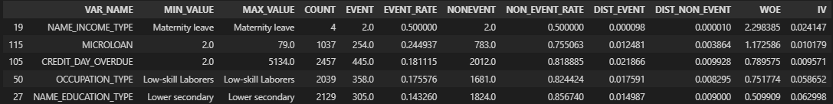
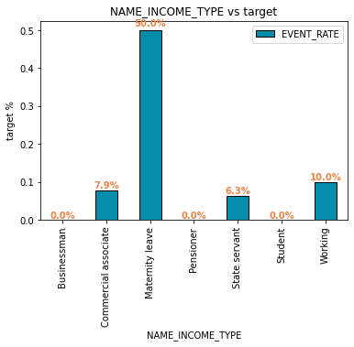
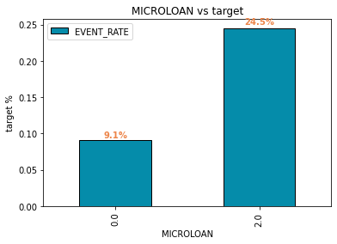
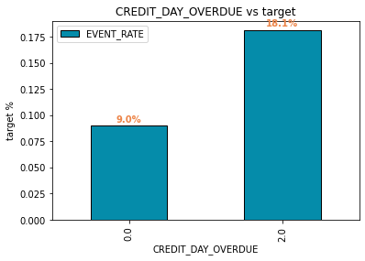
Exploratory Data Analysis (EDA)

Slide 7
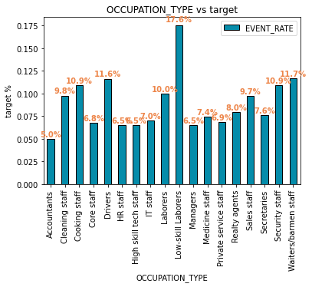
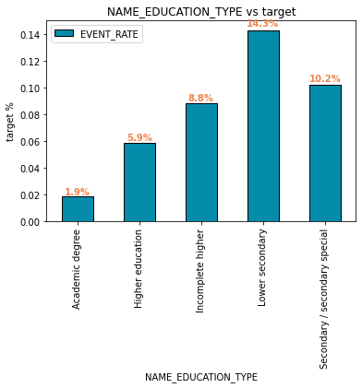
Exploratory Data Analysis (EDA)
Insight
Based on the highest WoE, some of the features describe default creditors:
NAME_INCOME_TYPE = Maternity Leave
MICROLOAN = 20%
CREDIT_DAY_OVERDUE = 2 Days
OCCUPATION_TYPE = Low-Skill Laborers
NAME_EDUCATION_TYPE = Lower Secondary

Slide 8
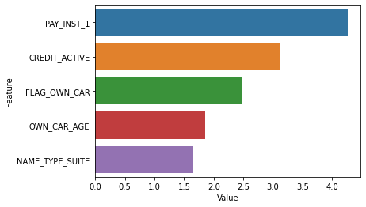
Feature Important
Business Recommendation
Credit analyst team must be aware of creditors who have a history of problems paying off credit applications
Based on historical data, if creditors have more credit active, the probability of default is high

Slide 9
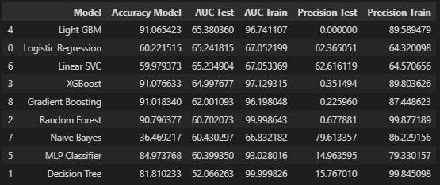
Modeling & Evaluation
DECILE | MIN | MAX
1 | 0.68723 | 0.95209
2 | 0.63183 | 0.68723
3 | 0.58848 | 0.63183
4 | 0.54811 | 0.58847
5 | 0.50796 | 0.54810
6 | 0.46644 | 0.50796
7 | 0.42112 | 0.46644
8 | 0.36818 | 0.42112
9 | 0.29705 | 0.36817
10 | 0.03655 | 0.29705
 | Very High Risk
 | High Risk
 | Medium Risk
 | Low Risk
 | Very Low Risk
The selected model is Logistic Regression
Using the Supervised Learning algorithm
Have a high Precision Test score to minimize false-negatives
Have a high AUC Test score to maximize credit scoring
Insight
The higher the score, the higher the probability that creditors will default
Creditors on Decile 1 can be rejected because it has a high probability of default

Slide 10
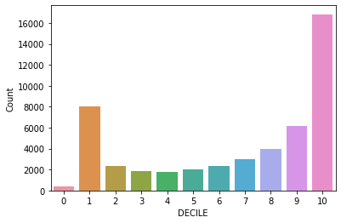
Result
Business Recommendation
From 48,788 creditors, it has 8,434 creditors were found to have a high risk of default. Therefore, these creditors can be rejected on applying credits to minimize the number of credit defaults.

